Slide 1
Web Services
CS5200

Slide 2
Setup
Download Apache cfx
http://www.apache.org/dyn/closer.cgi?path=/cxf/3.0.0-milestone2/apache-cxf-3.0.0-milestone2.zip
2. Download Eclipse IDE for Java EE Developers
http://www.eclipse.org/downloads/
3) Download apache-tomcat
http://tomcat.apache.org/download-70.cgi
(Optional, if you would like to use Glassfish server)
-Download java EE which contains glassfish4
4) configure Tomcat in Eclipse
(Window>Preferences>Server>Runtime Environment)

Slide 3
Web Services (java)
Client Application
Web Service
Client.java
SEI
XML (SOAP)
Convert Java object and variables into SOAP message
SEI: Service End Point Interface
XML: Extensible Markup Language
SOAP: Service Oriented Access Protocol

Slide 4
GeoIPService (Example)
www.webservicex.net
To be able to execute wsimport command, Add “C:\Program Files\Java\jdk1.7.0_45\bin” to your User and System Path variables.

Slide 5
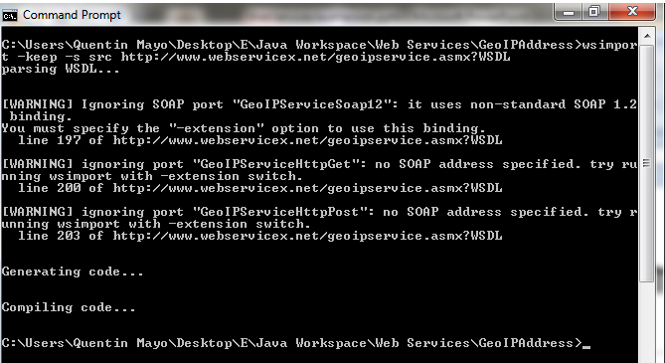
Use wsimport form java to generate SEI

Slide 6
Apache CXF
Apache CXF is an open source services framework.
CXF helps to build and develop services using frontend programming APIs, like JAX-WS and JAX-RS.
These services can speak a variety of protocols such as SOAP, XML/HTTP, RESTful HTTP, or CORBA and work over a variety of transports such as HTTP, JMS or JBI.

Slide 7
Install Java EE – glassfish4
Create JAVA_HOME user variable with the path to your java JDK.
Lunch localhost:4848
To stop all the services that run on the same port, just use netstat –ano through command prompt then find which service runs on the 8080 port and stop it

Slide 8
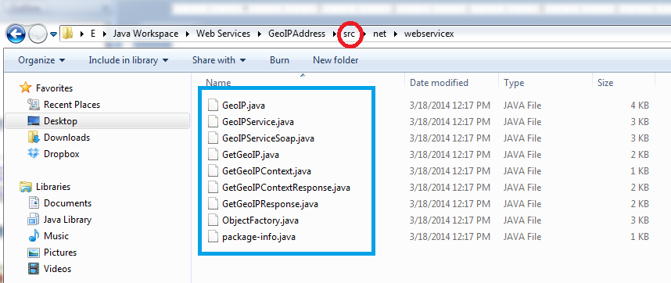
The .java files generated

Slide 9
WSDL for GameRegistry Service
http://cs5200web.serv.usu.edu/Registrar.svc?wsdl

